Slide 1
Bridge Design Pattern
Vivek Kolambe

Slide 2
What are Design Patterns?
Design Patterns are reusable solutions to recurring challenges that arise in software design.
They provide a template for solving specific design challenges in object-oriented programming.
Characteristics:
Reusable Solutions: Design patterns are pre-defined solutions to recurring problems in software design. They save time and effort.
Not Code, but Guidelines: They are not actual code but general approaches or concepts that can be implemented in different ways.
Improve Code Quality: Using design patterns makes code more organized, readable, and maintainable.
Types:
1. Creational Patterns 2. Structural Patterns 3. Behavioral Patterns

Slide 3
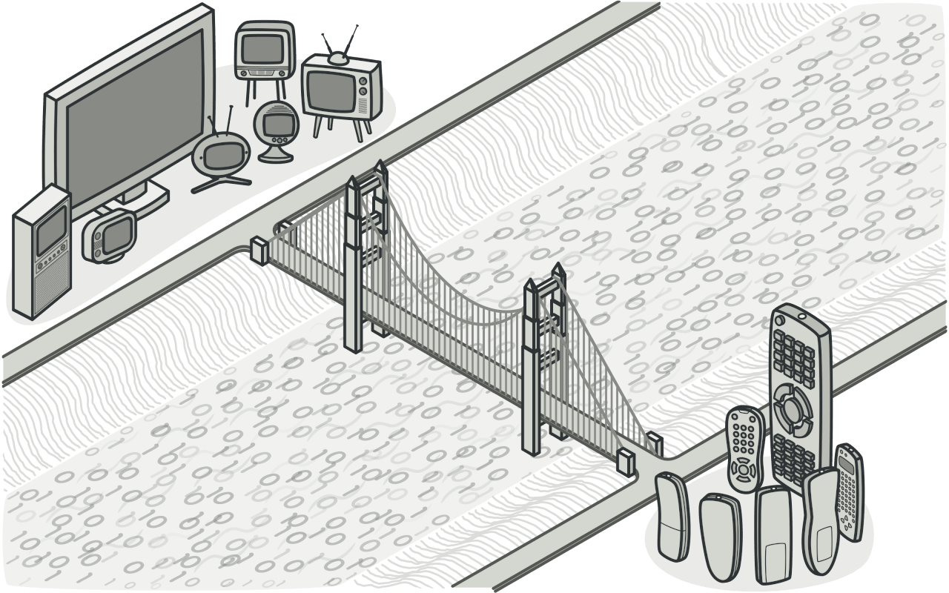
Bridge Design Pattern
The Bridge pattern decouples an abstraction from its implementation, allowing both to vary independently
It "bridges" the gap between them.

Slide 4
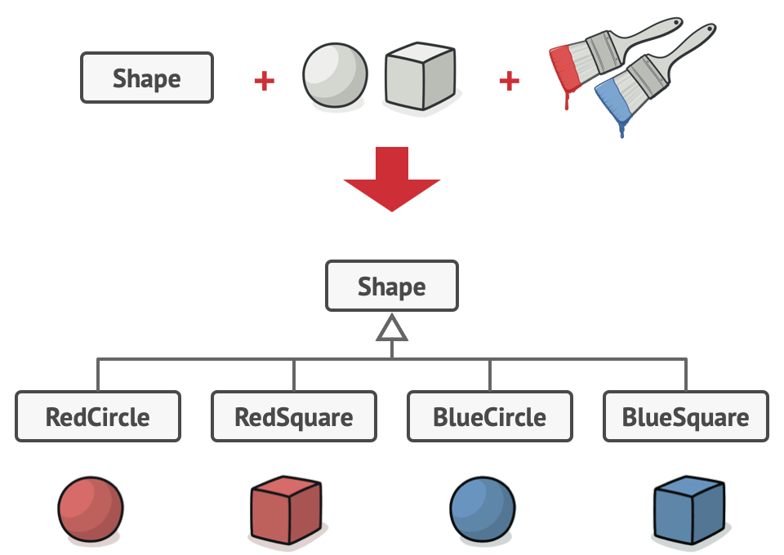
Problem
When we don't use the Bridge Design Pattern, abstraction and implementation become tightly coupled, extending one without affecting the other is challenging.(Tight Coupling)(Diff in extending)
Without the Bridge Pattern, if you have a system with multiple abstractions and implementations, you might end up creating a large number of subclasses.(Class Explosion-2 many subclasses)(Rigid)

Slide 5
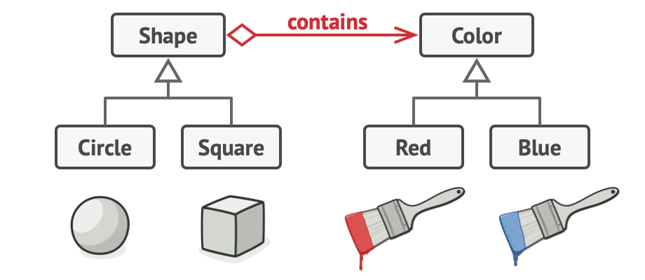
Solution
Instead of using inheritance, the Bridge Pattern uses composition.
Instead of making a class handle everything bridge pattern separates concerns and let each class focus on only one thing.
Instead of combining both Shape and Color into one big class hierarchy, we create two independent hierarchies
Shapes
Colors
Notes:
The Bridge Pattern separates the abstraction (e.g., the Shape) from its implementation (e.g., the Color) by creating separate classes for both. This allows changes to either the abstraction or the implementation without affecting the other.Solution: Instead of having combinations like RedCircle, GreenCircle, etc., you have a Shape abstraction with a Color implementation. The Shape class refers to a Color object, but the two can evolve independently.Benefit: You can add new shapes or new colors without modifying existing code, significantly reducing the number of required subclasses.
Instead of using inheritance (where each class inherits from a base class and combines both behavior and state), the Bridge Pattern uses composition (where classes hold references to objects from other classes).

Slide 6
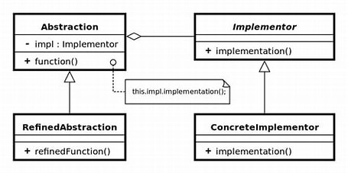
Structure of the Bridge Pattern
Bridge : Separates an abstraction from its implementation, allowing both to vary independently.
Abstraction: Defines the high-level interface that uses the Implementer object.
Refined Abstraction : Extends the abstraction, but still relies on the Implementer for specific operations.
Implementor : Defines a common interface for all concrete implementations.
Concrete Implementer : Provides the actual implementation.
Client: Interacts with the Abstraction.
Notes:
Abstraction: Contains a reference to an Implementer object and delegates the task to the Implementer. The Abstraction defines high-level methods that the Refined Abstraction and Concrete Implementer provide implementations for.
Refined Abstraction: Extends the abstraction by adding additional functionality, but still relies on the Implementer for specific operations.
Implementer: Defines a common interface for all concrete implementations. The Abstraction will not directly implement the behavior, it relies on the Implementer to do so.
Concrete Implementer: Provides specific implementations for the Implementer interface. The concrete classes define the details of operations, such as how shapes are drawn or how colors are applied.
The Abstraction holds a reference to the Implementer and delegates specific tasks to it.The
Refined Abstraction extends the Abstraction with more detailed behavior.The
Implementer defines a common interface for all concrete implementations, allowing flexibility in what the Abstraction uses.
Concrete Implementers implement the actual details of the operations, like how the color is applied or how the shape is drawn.
Key Components of the Bridge Pattern
Abstraction:
Purpose: Defines the high-level interface that uses the Implementer object.
Responsibility: The abstraction class contains a reference to an Implementer object and delegates work to it. It may also define some abstract operations that can be implemented by the concrete implementers.
Example: Shape (represents the abstraction of different shapes, like Circle, Square).
Refined Abstraction:
Purpose: Extends the Abstraction class and provides additional functionality specific to the abstraction.
Responsibility: It implements any abstract methods from Abstraction and may add new functionality.
Example: Circle, Square (specific types of shapes, which add functionality on top of the Shape abstraction).
Implementer:
Purpose: Defines the interface for the implementation classes.
Responsibility: This interface is implemented by concrete classes that perform the actual work (e.g., drawing the shape, filling with color).
Example: Color (defines an interface for coloring objects).
Concrete Implementer:
Purpose: Provides the actual implementation of the Implementer interface.
Responsibility: This class performs the concrete operations as defined in the Implementer interface.
Example: Red, Blue (specific implementations of the Color interface that implement the

Slide 7
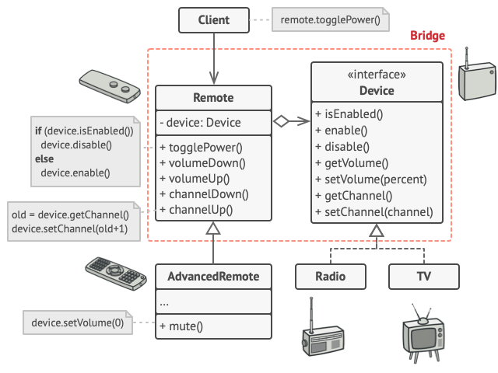
Real-World Analogy: Remote and Device
Notes:
Breakdown:
Abstraction: Represents the Vehicle and defines high-level methods that will interact with engines.
Example: Vehicle class with methods like start(), stop(), accelerate().
Implementor: Represents the Engine interface that defines methods like ignite(), stopEngine(), accelerateEngine(). This is what the vehicle relies on but doesn't need to know the details of.
Concrete Implementor: Represents specific engine types, like ElectricEngine, PetrolEngine, DieselEngine. These concrete engines implement the methods defined in the Engine interface.
Refined Abstraction: Concrete implementations of specific vehicle types, like Car, Truck, or Motorcycle, which extend the Vehicle abstraction and utilize a specific engine (concrete implementor).
Example: Car uses ElectricEngine, Truck uses DieselEngine.
Client: The client interacts with a Vehicle object (e.g., Car), calling methods like start() or accelerate(). The vehicle object, in turn, delegates these requests to the engine (concrete implementor) it is using.

Slide 8
Real-World Analogy: Data Converter
Components:
Abstraction (DataConverter)
Implementor (FormatConversion)
Concrete Implementor (JsonToXmlConverter, XmlToJsonConverter)
Refined Abstraction (JsonToXmlConverter, XmlToJsonConverter extending DataConverter)
Client: The client simply calls convert(data) on the DataConverter, and the system handles the conversion via the implementors.
Notes:
Abstraction: Contains a reference to an Implementer object and delegates the task to the Implementer. The Abstraction defines high-level methods that the Refined Abstraction and Concrete Implementer provide implementations for.
Refined Abstraction: Extends the abstraction by adding additional functionality, but still relies on the Implementer for specific operations.
Implementer: Defines a common interface for all concrete implementations. The Abstraction will not directly implement the behavior, it relies on the Implementer to do so.
Concrete Implementer: Provides specific implementations for the Implementer interface. The concrete classes define the details of operations, such as how shapes are drawn or how colors are applied.
The Abstraction holds a reference to the Implementer and delegates specific tasks to it.The
Refined Abstraction extends the Abstraction with more detailed behavior.The
Implementer defines a common interface for all concrete implementations, allowing flexibility in what the Abstraction uses.
Concrete Implementers implement the actual details of the operations, like how the color is applied or how the shape is drawn.
Key Components of the Bridge Pattern
Abstraction:
Purpose: Defines the high-level interface that uses the Implementer object.
Responsibility: The abstraction class contains a reference to an Implementer object and delegates work to it. It may also define some abstract operations that can be implemented by the concrete implementers.
Example: Shape (represents the abstraction of different shapes, like Circle, Square).
Refined Abstraction:
Purpose: Extends the Abstraction class and provides additional functionality specific to the abstraction.
Responsibility: It implements any abstract methods from Abstraction and may add new functionality.
Example: Circle, Square (specific types of shapes, which add functionality on top of the Shape abstraction).
Implementer:
Purpose: Defines the interface for the implementation classes.
Responsibility: This interface is implemented by concrete classes that perform the actual work (e.g., drawing the shape, filling with color).
Example: Color (defines an interface for coloring objects).
Concrete Implementer:
Purpose: Provides the actual implementation of the Implementer interface.
Responsibility: This class performs the concrete operations as defined in the Implementer interface.
Example: Red, Blue (specific implementations of the Color interface that implement the

Slide 9
Pros and Cons of Bridge Pattern
Pros
Improved maintainability: Reduces code duplication by reusing implementations.
Separation of concerns: Divides abstraction and implementation, allowing independent changes.
Enhanced reusability: Implementations can be reused across different systems with different abstractions.
Cons
Complexity: Increases system complexity due to additional layers (abstraction and implementation).
Learning curve: May be harder to understand for developers unfamiliar with design patterns.
Possible overuse: If not carefully used, it may introduce unnecessary complexity, especially in small projects.
.

Slide 10
When to use Bridge Pattern
Avoiding Code Duplication: When you need to avoid repetitive code by separating the implementation from the abstraction and allowing reusability.
Platform or Technology Independence: You need to support different platforms or technologies, but want to keep the abstraction consistent.
Simplifying Complex Systems: When working with a large, complex system where you need a clear separation of responsibilities to reduce tight coupling.

Slide 11




THANK YOU
(844) 720-6678
info@simplifyhealthcare.com
simplifyhealthcare.com
Simplify Healthcare
U.S.: 600 N Commons Drive, Suite 110, Aurora, IL 60504
India: 401/402, 4th Floor, Pentagon P-2, Magarpatta City, Pune 411013
CONNECT WITH US
LinkedIn
YouTube
X
Instagram

